Slide 1
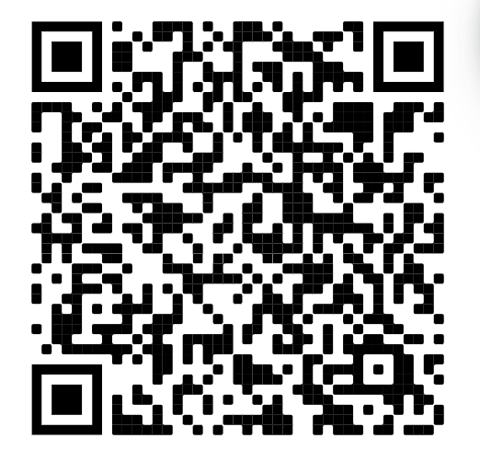
Mock Interview Night :D
Sign in →

Slide 2
Announcements
I dont think there are any, but yk the vibe you can just ask if there are any questions

Slide 3
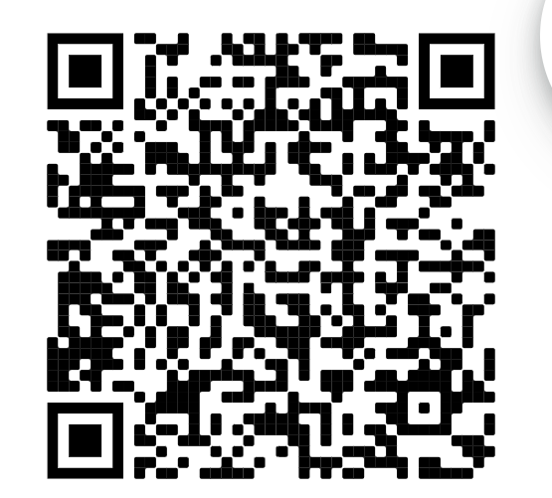
Slays of the Week
Sherryl (Former WiCS Business Manager)got a full time offer at Google!!!!!!!! Slay Sherryl
Shreya (our amazing vice president) accepted an internship!! Go Shreya!!

Slide 4
Anti slays of the week
Dont ask anita shreya or allison about the 1501 midterm
Or assignment 1 for that matter
THE MF WIND WHAT IS UP WITH THAT

Slide 5
SOOOO mock interviews yuh
Some tips:
-I don’t care if you’re super shy and quiet you show up to that interview and pretend like you’re steve harvey
-They love leadership and how you appreciate management/leaders
-Use your resume as a guide!
-There is nothing wrong with asking for more time to think or ask for clarification on a question
-exception to the rule about slapping shit on your linkedin, this does NOT apply to the resume
-it’s just a conversation, don’t stress too much

Slide 6
Format of tonight
-Elevator pitches (ex.)
-General Interview questions
-SPECIFIC questions about your resume experiences

